Slide 1
File System Management File System Implementations
Lecture 11 (Live Version)

Slide 2
Overview
File System Implementation:
File system layout
Disk organization
Implementation details for:
File Information
Free Space Management
Directory Structure
File System in Action
Disk I/O Scheduling (Not examinable)

Slide 3
File System Implementation: Overview
File systems are stored on storage media
Concentrate on hard disk in this lecture
General Disk Structure:
1-D array of logical blocks
Logical block:
Smallest accessible unit (Usually 512-bytes to 4KB)
Logical block is mapped into disk sector(s)
Layout of disk sector is hardware dependent

Slide 4





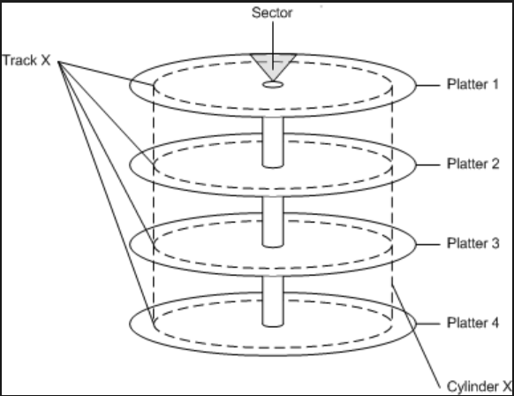
User ←→ OS ←→ Hardware: Views
….
file.txt
User
OS - FS
Storage

Slide 5
Disk Organization: Overview
Disk organization:
Master Boot Record (MBR) at sector 0 with partition table
Followed by one or more partitions
Each partition can contains an independent file system
A file system generally contains:
OS Boot-Up information
Partition details:
Total Number of blocks
Number and location of free disk blocks
Directory Structure
Files Information
Actual File Data

Slide 6
Generic Disk Organization
Simple Boot Code
Partition Table
Logical Blocks
MBR
Partition
Partition
Partition
……
Partition
OS Boot Block
Partition Details
Directory Structure
Files Info
File Data

Slide 7
Implementing File
OS Boot Block
Partition Details
Directory Structure
Files Info
File Data

Slide 8
File Implementation: Overview
Logical view of a file:
A collection of logical blocks
When file size != multiple of logical blocks
Last block may have internal fragmentation
A good file implementation must:
Keep track of the logical blocks
Allow efficient access
Disk space is utilized effectively
➔focuses on how to allocate file data on disk

Slide 9
File Block Allocation 1: Contiguous
General Idea:
Allocate consecutive disk blocks to a file
Pros:
Simple to keep track:
Fast access (only need to seek to first block)
Cons:
External Fragmentation
File size need to be specified in advance
Notes:
Cons:
External Fragmentation
Think of each file as a variable-size "partition"
Over time, with file creation/deletion, disk can have many small "holes"
File size need to be specified in advance

Slide 10
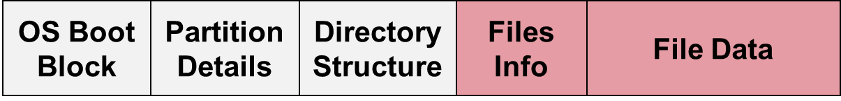
Contiguous Block Allocation
file size
count 2
tr 3
mail 6
list 4
f 2
start length
0 2
14 3
19 6
28 4
6 2
0
1
2
3
4
5
6
7
8
9
10
11
12
13
14
15
16
17
18
19
20
21
22
23
24
25
26
27
28
29
30
31

Slide 11
File Block Allocation 2: Linked List
General Idea:
Keep a linked list of disk blocks
Each disk block stores:
The next disk block number (i.e. act as pointer)
Actual file data
File information stores:
First and last disk block number
Pros:
Solve fragmentation problem
Cons:
Random access in a file is very slow
Part of disk block is used for pointer
Less reliable (what if one of the pointers is incorrect?)

Slide 12
Linked List Allocation
file size
jeep 5
start
9
end
25
0
1
2
3
4
5
6
7
8
9
10
11
12
13
14
15
16
17
18
19
20
21
22
23
24
25
26
27
28
29
30
31

Slide 13
File Block Allocation 2: Linked List V2.0
General Idea:
Move all the block pointers into a single table
known as File Allocation Table (FAT)
FAT is in memory at all time
Simple yet efficient
Used by MS-DOS

Slide 14
FAT Allocation
file size
jeep 5
start end
9 25
0
1
2
3
0
4
5
6
7
1
1
10
8
9
10
11
X
Y
12
13
14
15
9
16
16
17
18
19
10
25
Y
…..
20
21
22
23
16
1
24
25
26
27
25
-1
28
29
30
31
n-1

Slide 15
File Block Allocation 2: Linked List V2.0
General Idea:
Move all the block pointers into a single table
known as File Allocation Table (FAT)
FAT is in memory at all time
Simple yet efficient
Used by MS-DOS
Pros:
Faster Random Access
The linked list traversal now takes place in memory
Cons:
FAT keep tracks of all disk blocks in a partition
Can be huge when disk is large
Consume valuable memory space
E

Slide 16
File Block Allocation 3: Indexed Allocation
General Idea:
Each file has an index block
An array of disk block addresses
IndexBlock[ N ] == N^{th} Block address
Pros:
Lesser memory overhead
Only index block of opened file needs to be in memory
Fast direct access
Cons:
Limited maximum file size
Max number of blocks == Number of index block entries
Index block overhead

Slide 17
Indexed Allocation
file
jeep
index block
19
0
1
2
3
4
5
6
7
8
9
10
11
9
16
1
10
25
-1
-1
-1
12
13
14
15
16
17
18
19
19
20
21
22
23
24
25
26
27
28
29
30
31

Slide 18
Indexed Block Allocation: Variation
Several schemes to allow larger file size
Linked scheme:
Keep a linked list of index blocks
Multilevel index:
Similar idea as multi-level paging
Can be generalized to any number of levels

Slide 19
Indexed Block Allocation: Variation(cont)
Combined scheme:
Combination of direct indexing and multi-level index scheme

Slide 20
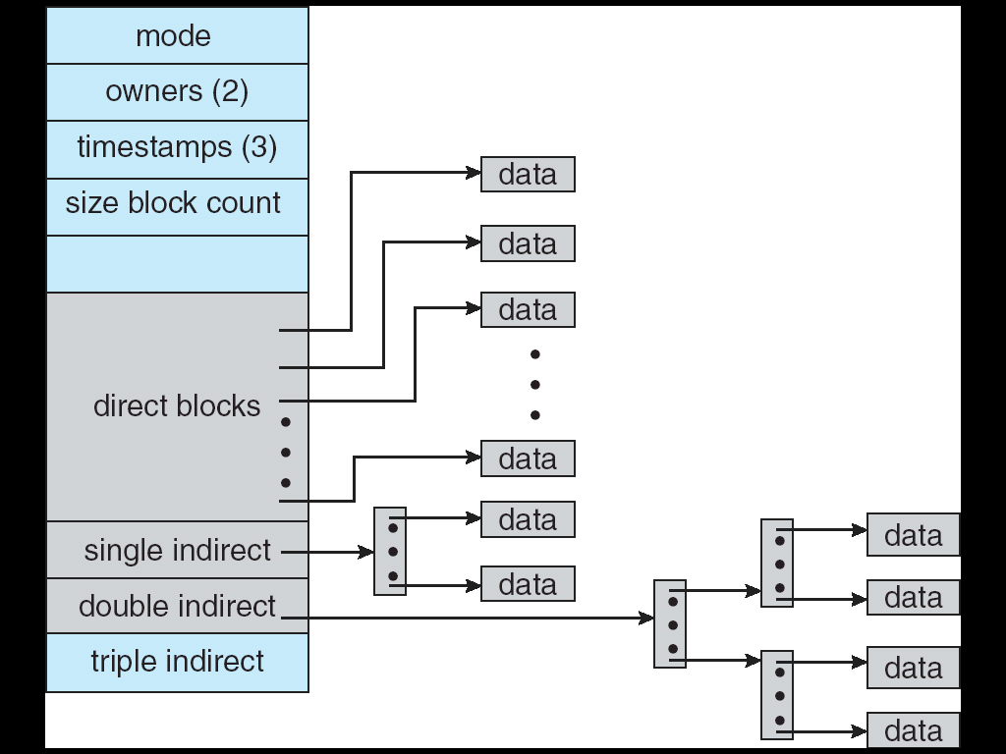
Unix Indexed Node

Slide 21
Free Space Management
OS Boot Block
Partition Details
Directory Structure
Files Info
File Data

Slide 22
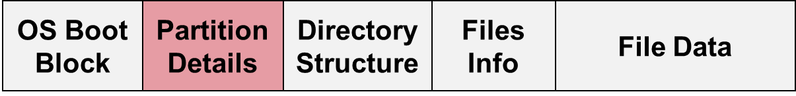
Free Space Management: Overview
To perform file allocation:
Need to know which disk block is free
Free space management:
Maintain free space information
Allocate:
Remove free disk block from free space list
Needed when file is created or enlarged (appended)
Free:
Add free disk block to free space list
Needed when file is deleted or truncated

Slide 23
Free Space Management: Bitmap
Each disk block is represented by 1 bit
0 1 0 1 1 1 0 0 1 0 1 1 ......
Occupied Blocks = 0, 2, 6, 7, 9, …
Free Blocks = 1, 3, 4, 5, 8, 10, 11, …
Pros:
Provide a good set of manipulations
Cons:
Need to keep in memory for efficiency reason

Slide 24
Free Space Management: Linked List
Use a linked list of disk blocks:
Each disk block contains:
A number of free disk block numbers
A pointer to the next free space disk block
Pros:
Easy to locate free block
Only the first pointer is needed in memory
Though other blocks can be cached for efficiency
Cons:
High overhead
0
1
2
3
4
5
6
7
8
9
10
11
12
13
14
15
16
17
18
19
20
21
22
23
24
25
26
27
28
29
30
31

Slide 25
Implementing Directory
OS Boot Block
Partition Details
Directory Structure
Files Info
File Data

Slide 26
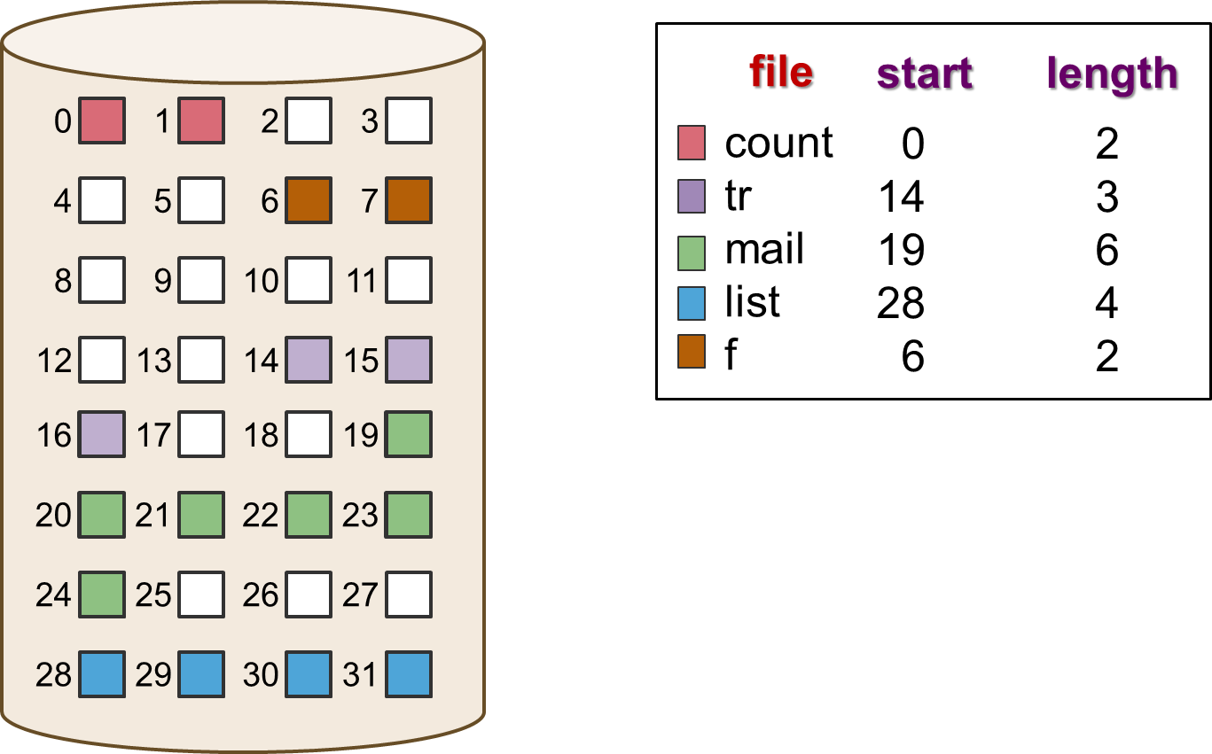
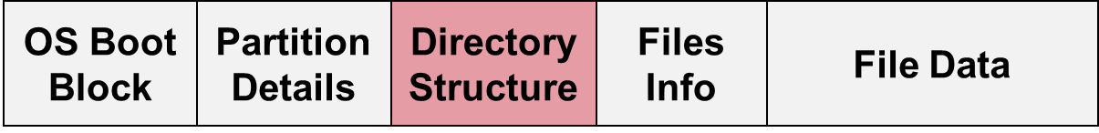
Directory Structure: Overview
Two main tasks:
Keep tracks of the files in a directory
Possibly with the file metadata
Map the file name to the file information
Remember:
File must be opened before use
Something like open( "data.txt" );
The purpose of the open operation:
Locate the file information using pathname + file name

Slide 27
Directory Structure: Overview (cont)
Given a full path name:
Need to recursively search the directories along the path to arrive at the file information
Sub-directory is usually stored as file entry with special type in a directory
/dir2/dir3/data.txt

Slide 28
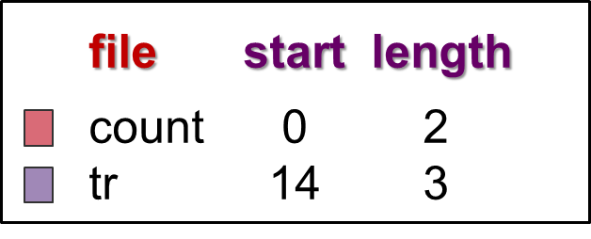
Directory Implementation: Linear List
Directory consists of a list:
Each entry represents a file:
Store file name (minimum) and possibly other metadata
Store file information or pointer to file information
Locate a file using list:
Requires a linear search
Inefficient for large directories and/or deep tree traversal
Common solution:
Use cache to remember the latest few searches

Slide 29
Directory Implementation: Hash Table
Each directory contains a
Hash table of size N
To locate a file by file name:
File name is hashed into index K from 0 to N-1
HashTable[K] is inspected to match file name
Usually chained collision resolution is used
Pros:
Fast lookup
Cons:
Hash table has limited size
Depends on good hash function

Slide 30
Directory Implementation: File Information
File information consists of:
File name and other metadata
Disk blocks information
Two common approaches to store:
Store everything in directory entry
Store only file name and points to some data structure for other info

Slide 32
File System in Action

Slide 33
File System in Action: Overview
Previous sections are on static information for a FS stored on media
At runtime, when user interacts with file:
Run-time information is needed
Maintained by OS in memory
[Recap] Common in-memory information:
System-wide open-file table
Per-process open-file table
Buffers for disk blocks read from/written to disk

Slide 35
Walkthrough on file operation: Create
To create a file /…/…/parent/F:
Use full pathname to locate the parent directory
Search for filename F to avoid duplicates
If found, file creation terminates with error
Search could be on the cached directory structure
Use free space list to find free disk block(s)
Depends on allocation scheme
Add an entry to parent directory
With relevant file information
File name, disk block information etc

Slide 36
File Creation
/ …/ …/ parent/ F
…
Directory Structure
Create( filePath, …)
Files Info
…
File Data
User Program
Directory Structure
(Can be cached in memory)
Secondary
Storage

Slide 37
Walkthrough on file operation: Open
Process P open file /…/…/…/F:
Search system-wide table for existing entry E
If found:
Creates an entry in P's table to point to E
Return a pointer to this entry
If not found, continue to next step
Use full pathname to locate file F
If not found, open operation terminates with error
When F is located, its file information is loaded into a new entry E in system-wide table
Creates an entry in P's table to point to E
Return a pointer to this entry
The returned pointer is used for further read/write operation

Slide 38
File Open: Improved Understanding
0
Directory Structure
Proc P PCB
…
…
Open( filePath, …)
0
1
Files Info
…
…
File1.abc
fd
File Data
File Descriptor
Table
E
Op.Type: Read
File offset: 1234
"File Data":
Op.Type: …
File Info:
File Data:
…
…
Secondary
Storage
"Actual File"
Open File Table

Slide 39
disk I/O Scheduling (NOT EXAMINABLE)
I'm afraid you have to wait…..

Slide 40
Magnetic Disk in One Glance
Rotation
(Change Sector)
Seek
(Change Track)

Slide 41
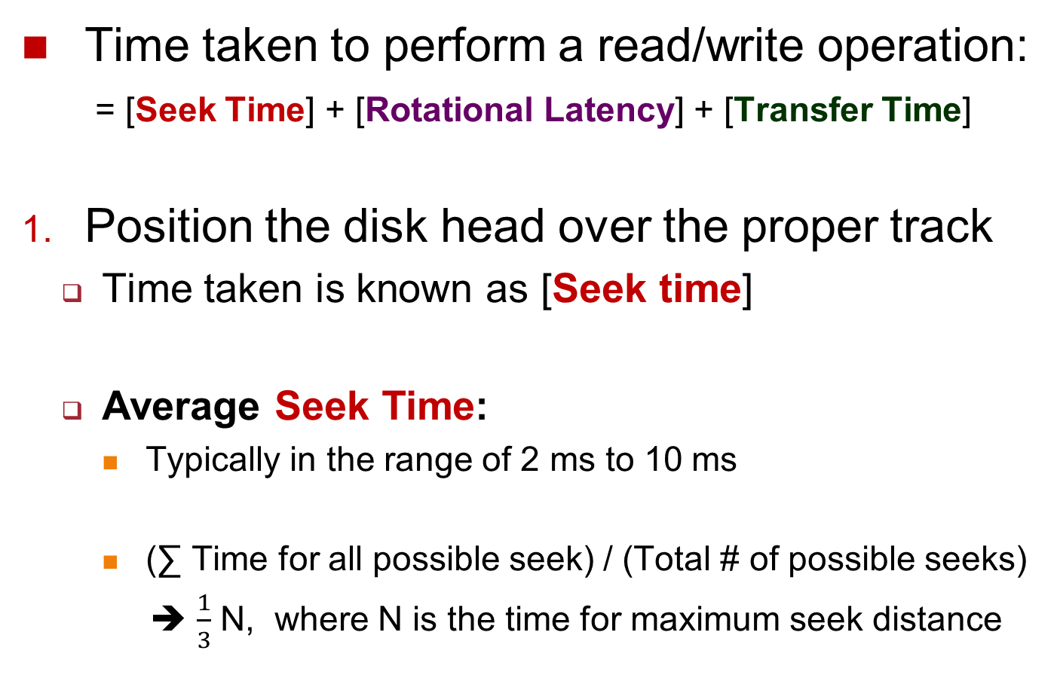
3-Stage of Read/Write Process (1/3)
Time taken to perform a read/write operation:
= [Seek Time] + [Rotational Latency] + [Transfer Time]
Position the disk head over the proper track
Time taken is known as [Seek time]
Average Seek Time:
Typically in the range of 2 ms to 10 ms
(∑ Time for all possible seek) / (Total # of possible seeks)
➔ $\frac{1}{3}$ N, where N is the time for maximum seek distance
Notes:
http://pages.cs.wisc.edu/~remzi/OSFEP/file-disks.pdf

Slide 42
3-Stage of Read/Write Process (2/3)
Wait for the desired sector to rotate under the read/write head
Time taken is known as [Rotational latency]
Rotation speed: 4800 to 15000 rotations per minute (RPM)
➔ 12.5 ms to 4 ms per rotation respectively
Average Rotational Latency:
Assume desired data is halfway around the track
➔ 6.25 ms at 4800 RPM, 2 ms at 15000 RPM

Slide 43
3-Stage of Read/Write Process (3/3)
Transfer the sector(s)
Time taken is known as [Transfer time]
Transfer Time is a function of :
Transfer size / Transfer Rate
Transfer size: [X KB / Sector] x [ # of Sectors]
Transfer rate: 70 to 125 MB / second
E.g. If we read 2 consecutive sectors of 512 Bytes
Transfer size = 512B x 2 = 1KB
Assuming a transfer rate of 100MB/second
Transfer time = 1KB / 100MB per second
= 2¹⁰ / 100 x 2²⁰ = 9.7µs
(1) + (2) is significantly more than (3)

Slide 44
Disk Scheduling: The Problem
Due to the significant seek and rotational latency, OS should schedule the disk I/O requests
With the intention of reducing overall waiting time
As rotational latency is hard to mitigate, we focus on reducing the seeking time
Consider the following disk I/O requests indicated by only the track number:
13, 14, 2, 18, 17, 21, 15
Use the following algorithms to schedule these I/O requests

Slide 45
Disk Scheduling: Algorithms
A few obvious candidates:
FCFS
SSF (Shortest Seek First)
13, 14, 2, 18, 17, 21, 15

Slide 46
FCFS: Disk Head Movement
Request: [13, 14, 2, 18, 17, 21, 15 ]

Slide 47
SSF: Disk Head Movement
Request: [13, 14, 2, 18, 17, 21, 15 ]

Slide 48
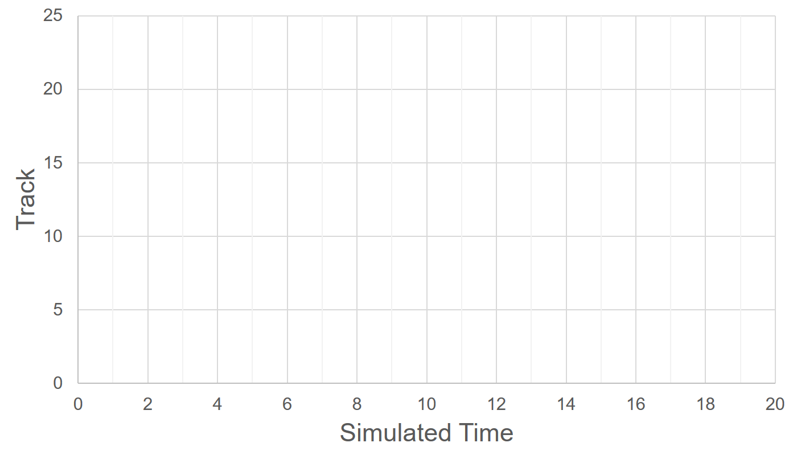
SCAN: Disk Head Movement
Bi-Direction [Innermost ←→ Outermost] (SCAN)
Request: [13, 14, 2, 10, 17, 21, 7 ]
E

Slide 49
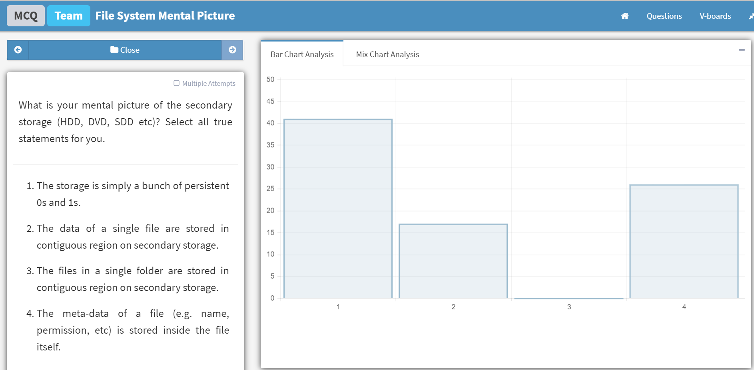
Summary
Covered implementation details for file system
File Information
Allocation schemes
Free Space management
Directory Structure
Relook at file operations from the OS viewpoint
Discussed OS responsibility in I/O scheduling

Slide 50
Blank
file size
count 2
tr 3
mail 6
list 4
f 2
0
1
2
3
4
5
6
7
8
9
10
11
12
13
14
15
16
17
18
19
file start length
count 0 2
tr 14 3
mail 19 6
list 28 4
f 6 2
20
21
22
23
24
25
26
27
28
29
30
31

Slide 51
Contiguous Block Allocation
file size
count 2
tr 3
mail 6
list 4
f 2
start length
0 2
14 3
19 6
28 4
6 2
0
1
2
3
4
5
6
7
8
9
10
11
12
13
14
15
16
17
18
19
20
21
22
23
24
25
26
27
28
29
30
31

Slide 52
Linked List Allocation
file size
jeep 5
start end
9 25
0
1
2
3
4
5
6
7
8
9
10
11
12
13
14
15
16
17
18
19
20
21
22
23
24
25
26
27
28
29
30
31

Slide 53
